Slide 1


Education in America
18April20
Jennifer Borgogno
Cheryl Hornung
Elizabeth Overman
John Wittenborn

Slide 2
Education in America
What are major characteristics of education by state and demographics in the US?
What is the geographic variation of educational attainment?
What is the association between educational attainment and income?

Slide 3
Data Sources
US Census
American Community Survey API
Education data by state & county
Income data by state & county
Google Maps API
State and county-level mapping of education data
Population data by state

Slide 4
Pulling Data From Census API
API Documentation Review
Variable Selection & Refinement
Clean-up & DataFrame Creation

Slide 5
Example Data From Census API Call
Name | State FIPS | County FIPS | Household Income | Median Age | Median Male Age | Median Female Age | White | Black or African American | American Indian and Alaska Native | Asian | Native Hawaiian and Other Pacific Islander | Other | No Education | High School | GED | Some College | Associates Degree | Bachelors Degree | Professional Degree | Doctoral Degree
Monroe County, Alabama | 1 | 99 | 26036 | 41.7 | 39.4 | 43.4 | 11973 | 9029 | 274 | 116 | 0 | 0 | 375 | 6257 | 653 | 1673 | 1172 | 1079 | 67 | 121
Lawrence County, Alabama | 1 | 79 | 43779 | 42 | 40.6 | 42.8 | 25978 | 3801 | 1730 | 18 | 0 | 3 | 396 | 7870 | 1676 | 3269 | 1822 | 1671 | 62 | 42
Lee County, Alabama | 1 | 81 | 47564 | 31 | 29.7 | 32.4 | 109481 | 36139 | 166 | 6000 | 12 | 1987 | 1109 | 18345 | 4315 | 14958 | 7431 | 18261 | 1694 | 2922
Marion County, Alabama | 1 | 93 | 35719 | 44.1 | 42.3 | 45.3 | 28032 | 1003 | 128 | 96 | 0 | 232 | 227 | 6097 | 1466 | 3362 | 1902 | 1784 | 104 | 20
Pickens County, Alabama | 1 | 107 | 36220 | 42.1 | 40.3 | 44.1 | 11305 | 8189 | 22 | 13 | 10 | 331 | 339 | 4601 | 783 | 2230 | 1067 | 1248 | 46 | 30

Slide 6
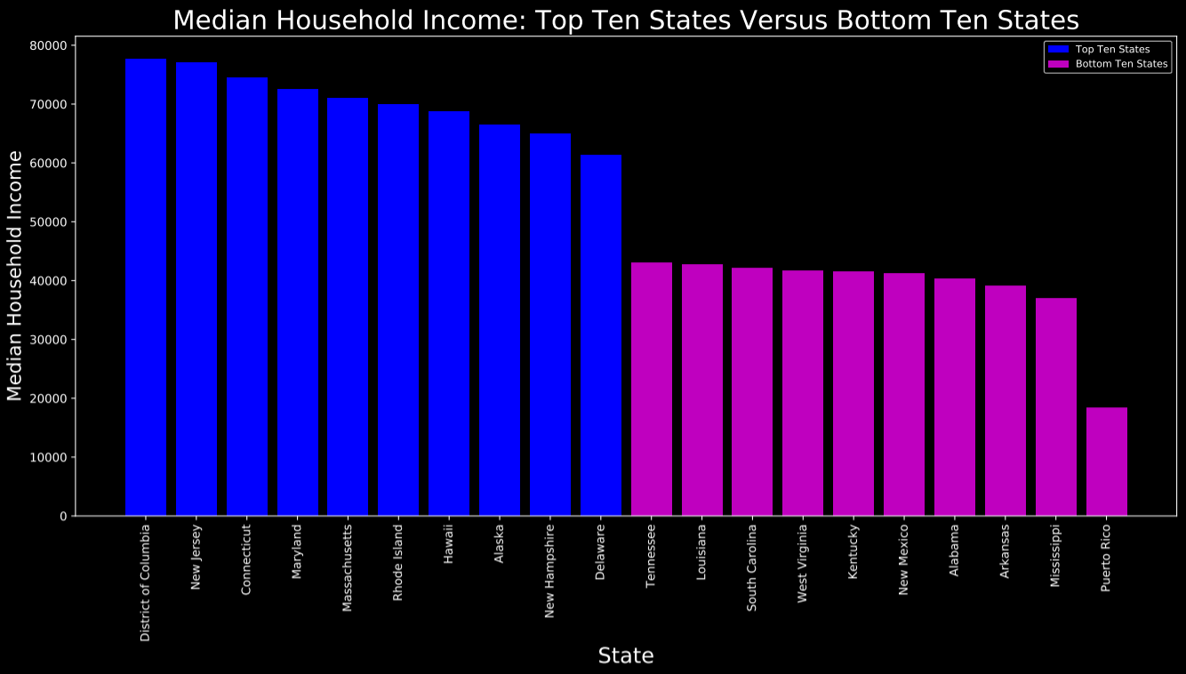
Median Household Income: Top Ten States Versus Bottom Ten States

Slide 7
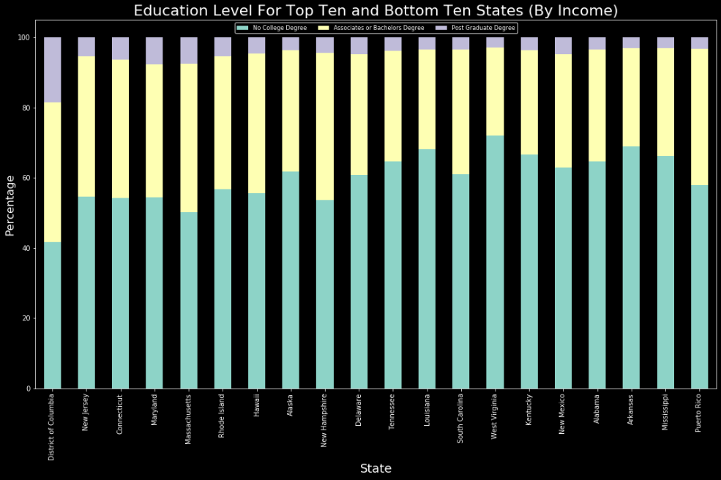
Education Level for the Top Ten and Bottom Ten States (by Income)

Slide 8
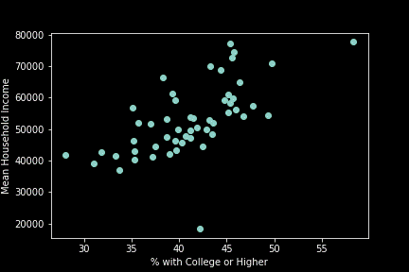
Association of Education and Income
‘Education’ = bachelors degree + post graduate degree
Clear correlation between ‘Education’ and income at the state level
Possible outliers

Slide 9
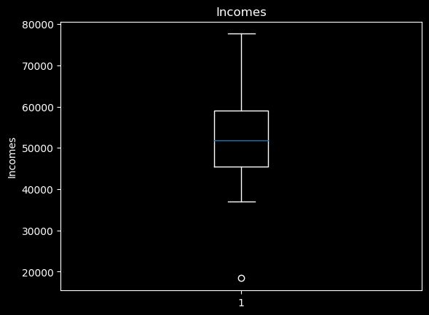
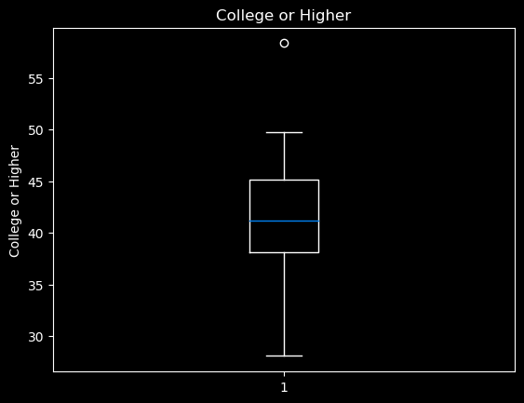
Removing Outliers
Washington DC
Puerto Rico

Slide 10
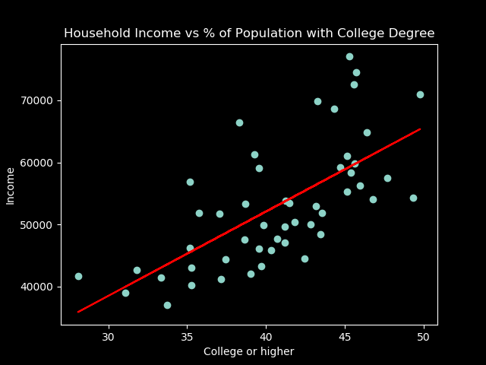
Higher education populations associated with higher income
10% increase in prevalence of college+ education is associated with a $13,584 increase in mean household income.

Slide 11
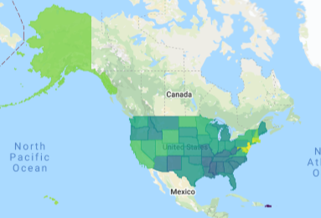
Household income by state
Dark Purple = Lowest average household income
Yellow = Highest average household income

Slide 12
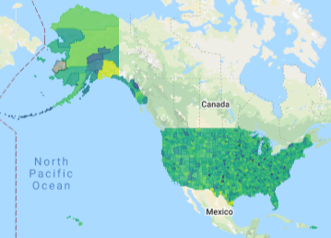
Household income by county
Dark Purple = Lowest average household income
Yellow = Highest average household income

Slide 13
Data Limitations and Conclusions
Limitations
All data is self-reported
Income is reported as household income bins
Correlation between education and income cannot be assumed to be entirely attributable to education
The 2 “non-states” were outliers
Puerto Rico for income
Washington DC for education
Conclusions
We found clear variation in mean household income and population education attainment by state and county
A 10% increase in ‘College or higher’ education levels in a population was associated with more than $13,000 in household income
There are large disparities in education attainment by state and county

